Slide 1
FAMILY DAY
Seek Ye First The Kingdom of God
And His Righteousness
Sunday PM:
Tristan Johnson
Sunday AM:
Eddie Williams
Stuart Fain
Matthew 6:33-34

Slide 2
Seek First the Kingdom of
God and His
Righteousness
Matthew 6:33–34
Eddie Williams

Slide 3
Matthew 6:33-34 (NASB)
³³ "But seek first His kingdom and His righteousness, and all these things will be provided to you.
³⁴ "So do not worry about tomorrow; for tomorrow will worry about itself. Each day has enough trouble of its own.

Slide 4
Matthew chapter 6 is part of Jesus' Sermon on the Mount, focusing on genuine religious motives, heavenly priorities, and trusting God for daily needs. It covers three main spiritual practices,
Motives in religious practices
The correct view of wealth
A command against worry

Slide 5
Scripture 1 (version)
Trebuchet MS (Body)
Minimum size = 54
Transition beginning of scripture = Doors
Transition subsequent pages = Page Curl

Slide 6
Motives in Religious Practices
Verses 1-18
Giving to the Needy (v. 1–4)
The Model for Prayer (v. 5–15)
Fasting (v. 16–18)

Slide 7
Treasures and Wealth
Verses 19 –24
Earthly vs. Heavenly Treasures (v. 19–21)
The Lamp of the Body (v. 22–23)
Two Masters (v. 24)

Slide 8
Overcoming Anxiety
Verses 25-34
Do Not Worry (v. 25–30)
Seek First His Kingdom (v. 31–34)

Slide 9
HOW TO
OVERCOME
ANXIETY

Slide 10
1) Attend Every Assembly of the Church
Hebrews 10:24-26 (NASB)
²⁴ and let's consider how to encourage one another in love and good deeds,
²⁵ not abandoning our own meeting together, as is the habit of some people,

Slide 11
Hebrews 10:24-26 (NASB)
but encouraging one another; and all the more as you see the day drawing near.
²⁶ For if we go on sinning willfully after receiving the knowledge of the truth, there no longer remains a sacrifice for sins,

Slide 12
2) Expand Your Prayer Life
I Thessalonians 5:17 (NASB)
pray without ceasing

Slide 13
3) Spend More Time in Studying Goc’s Word
I Timothy 4:15-16 (NASB)
¹⁵ Meditate upon these things; give thyself wholly to them; that thy profiting may appear to all.

Slide 14
I Timothy 4:15-16 (NASB)
¹⁶ Take heed unto thyself, and unto the doctrine; continue in them: for in doing this thou shalt both save thyself, and them that hear thee.

Slide 15
4) Focus on Using Your Spiritual
Gift to Grow the Church
I Corinthians 12:7 (NLT)
A spiritual gift is given to each of us so we can help each other.

Slide 16
5) Seek the Lost
Luke 19:10 (NASB)
"For the Son of Man has come to seek and to save that which was lost."

Slide 17
What Does It Mean to
Seek God’s
Righteousness First
And Not Your Own?
Matthew 6:33
Romans 10:1-4
Stuart Fain

Slide 18
Matthew 6:33 (KJV)
But seek ye first the kingdom of God, and his righteousness; and all these things shall be added unto you.

Slide 19
Romans 10:1-4 (NKJV)
¹ Brethren, my heart's desire and prayer to God for Israel is that they may be saved.
² For I bear them witness that they have a zeal for God, but not according to knowledge.

Slide 20
Romans 10:1-4 (NKJV)
³ For they being ignorant of God's righteousness, and seeking to establish their own righteousness, have not submitted to the righteousness of God.

Slide 21
Romans 10:1-4 (NKJV)
⁴ For Christ is the end of the law for righteousness to everyone who believes.
⁵ For Moses writes about the righteousness which is of the law, "The man who does those things shall live by them."

Slide 22
Three Reasons to Seek God’s Righteousness and Not Your Own

Slide 23
Zeal Without Knowledge Becomes Destruction,
Not Devotion

Slide 24
II Corinthians 9:2 (NASB)
for I know your readiness, of which I boast about you to the Macedonians, namely, that Achaia has been prepared since last year, and your zeal has stirred up most of them.

Slide 25
Philippians 3:6 (NASB)
concerning zeal, persecuting the church; concerning the righteousness which is in the law, blameless.

Slide 26
Self-Made Righteousness is Always Self-Deceived Righteousness

Slide 27
Romans 3:10 (NASB)
as it is written,
"THERE IS NONE RIGHTEOUS,
NOT EVEN ONE;

Slide 28
Ephesians 2:19-20 (NASB)
¹⁹ So then you are no longer strangers and aliens, but you are fellow citizens with the saints, and are of God's household, ²⁰ having been built on the foundation of the apostles and prophets, Christ Jesus Himself being the corner stone,

Slide 29
What You Seek First Determines What You Become

Slide 30
Matthew 6:31-33 (KJV)
³¹ Therefore take no thought, saying, What shall we eat? or, What shall we drink? or, Wherewithal shall we be clothed?
³² (For after all these things do the Gentiles seek:) for your heavenly Father knoweth that ye have need of all these things.

Slide 31
Matthew 6:31-33 (KJV)
³³ But seek ye first the kingdom of God, and his righteousness; and all these things shall be added unto you.

Slide 32
Seek Him first,
Seek Him early,
Seek Him always, Seek Him above all

Slide 33
Isaiah 26:9 (NKJV)
With my soul I have desired You in the night, Yes, by my spirit within me I will seek You early; For when Your judgments are in the earth, The inhabitants of the world will learn righteousness.

Slide 34
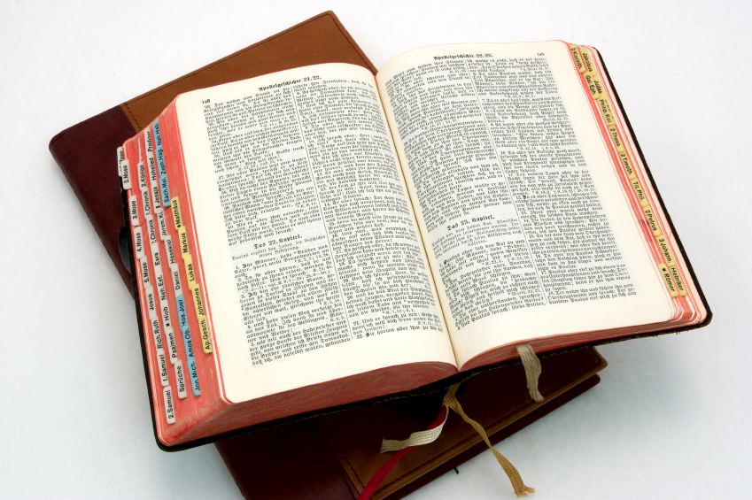
Hear: Romans 10:17
So then faith cometh by hearing, and hearing by the word of God.

Slide 35
Believe: Hebrews 11:6
But without faith it is impossible to please him: for he that cometh to God must believe that he is, and that he is a rewarder of them that diligently seek him.

Slide 36
Repent: Luke 13:3
I tell you, Nay: but, except ye repent, ye shall all likewise perish.

Slide 37
Confess: Matthew 10:32-33
32 Whosoever therefore shall confess me before men, him will I confess also before my Father which is in heaven.
33 But whosoever shall deny me before men, him will I also deny before my Father which is in heaven.

Slide 38
Baptize: Acts 22:16
And now why tarriest thou? arise, and be baptized, and wash away thy sins, calling on the name of the Lord.

Slide 39
Seeking God’s
Kingdom First Means
Not Forsaking the
Assembly of the Saints
Hebrews 10:23-26
Tristan Johnson

Slide 40
Hebrews 10:23-26 (NASB)
²³ Let us hold fast the confession of our hope without wavering, for He who promised is faithful;
²⁴ and let us consider how to stimulate one another to love and good deeds,

Slide 41
Hebrews 10:23-26 (NASB)
²⁵ not forsaking our own assembling together, as is the habit of some, but encouraging one another; and all the more as you see the day drawing near. ²⁶ For if we go on sinning willfully after receiving the knowledge of the truth, there no longer remains a sacrifice for sins,

Slide 42
FAMILY DAY
Seek Ye First The Kingdom of God
And His Righteousness
Sunday PM:
Tristan Johnson
Sunday AM:
Eddie Williams
Stuart Fain
Matthew 6:33-34

Slide 43
Hear: Romans 10:17
So then faith cometh by hearing, and hearing by the word of God.

Slide 44
Believe: Hebrews 11:6
But without faith it is impossible to please him: for he that cometh to God must believe that he is, and that he is a rewarder of them that diligently seek him.

Slide 45
Repent: Luke 13:3
I tell you, Nay: but, except ye repent, ye shall all likewise perish.

Slide 46
Confess: Matthew 10:32-33
32 Whosoever therefore shall confess me before men, him will I confess also before my Father which is in heaven.
33 But whosoever shall deny me before men, him will I also deny before my Father which is in heaven.

Slide 47
Baptize: Acts 22:16
And now why tarriest thou? arise, and be baptized, and wash away thy sins, calling on the name of the Lord.

